Slide 1
H2 In-memory Database. Introduction.

Slide 2
H2 Database Console Overview
H2 Console at http://localhost:8080/h2-console
# Enabling H2 Console
/src/main/resources/application.properties
spring.h2.console.enabled=true

Slide 3
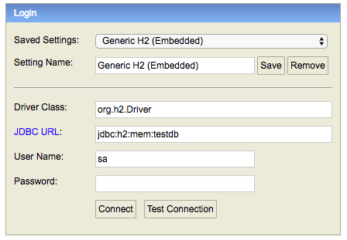
Tip - Make sure that you use jdbc:h2:mem:testdb as JDBC URL.

Slide 4
Adding Support for the H2 Database
<dependency> <groupId>com.h2database</groupId> <artifactId>h2</artifactId> <scope>runtime</scope>
</dependency>
Accessing H2 DB Console of ‘Users’ microservice via zuul
http://localhost:8011/users-ws/h2-console

